Slide 1
JDE Queue and Batch job analysis
By Rohan D. Shah

Slide 2
What will be covered?
Background
Technology and services used
Problem dealt
The solution
Expectations
Applying the solution
Challenges in the project
Outcome after applying the solution
Future work
My learning

Slide 3
Background
UBEs
JDE - ERP software of the company
UBEs for operations and tasks
Processing done in a job queue
Job queue
Processes the UBEs and version submitted according to definition
Single threaded or multi-threaded
Tables to maintain queue records:-
job control master table (F986110) - status of submitted jobs
Queue control status master table (F986130) – existing queue information

Slide 4
Services used
Visual studio ultimate 2012
Microsoft SQL server Management studio
Microsoft SQL 2008
Microsoft excel
Power Query
Power View
JDE oneWorld 8.12
Object Management Workbench (OMW)

Slide 5
Scope
Only production environment
Only custom versions
Only user initiated processes and user applications

Slide 6

What is the problem?
Default queue – QBATCH – getting backed up
Terminating data collision and data corruption
Waiting time too long for processing the jobs

Slide 7

The solution
Optimize thread capacity
Keep single-threaded UBEs in a single threaded queue
All versions of UBE in the same queue
Restructure QBATCH
Create new job queues
Putting UBEs in correct queue

Slide 8

Expectations
Decrease in the wait time
Elimination of data collision and data corruption
Data integrity
Improvement in the processing efficiency of queues, in particular QBATCH

Slide 9
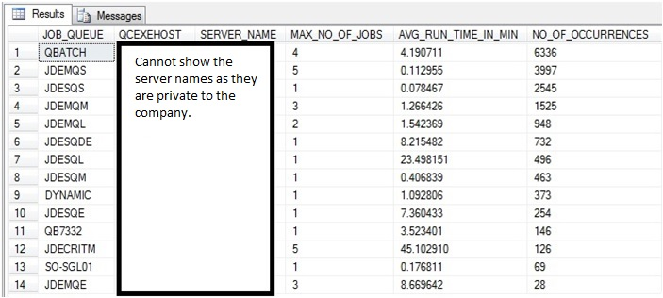
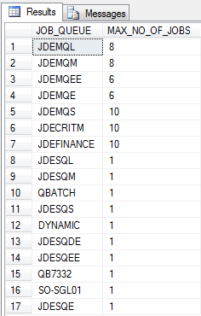
Optimizing thread count
Increasing threads in multi-threaded queues
Optimizing the increase so that it does not backfires
Average runtime and number of occurrences of UBE – important parameters
Doubling the thread count of multi threaded queues

Slide 10
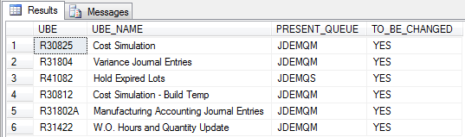
Single threaded UBEs in single threaded queues
UBEs from white paper and from David B.
UBEs to be ran together in a single threaded environment
New queues assigned on the basis of their runtime

Slide 11
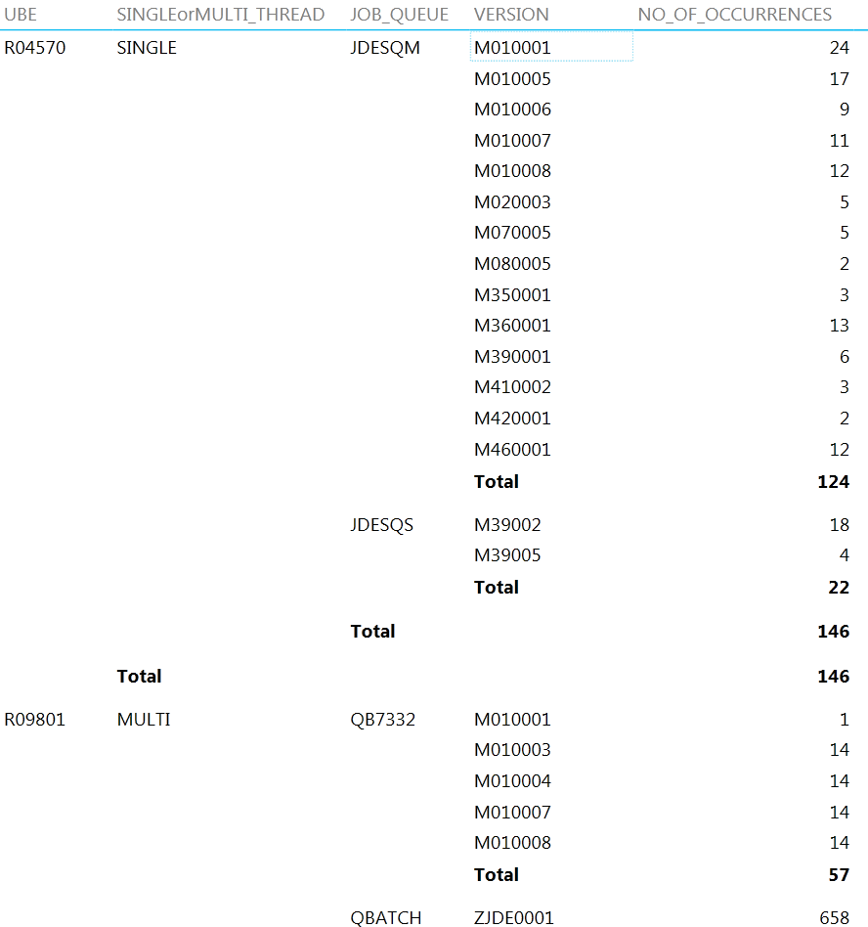
Different versions in same queue
Complex task in terms of programming and analyzing it
Store the info from the appropriate table in a temp table
Group the UBEs in the temp table and store the UBE and the count in another temp table
Join the appropriate tables with the last temp table where the count > 1 to get the UBEs whose versions are in different queues
33 UBEs found

Slide 12
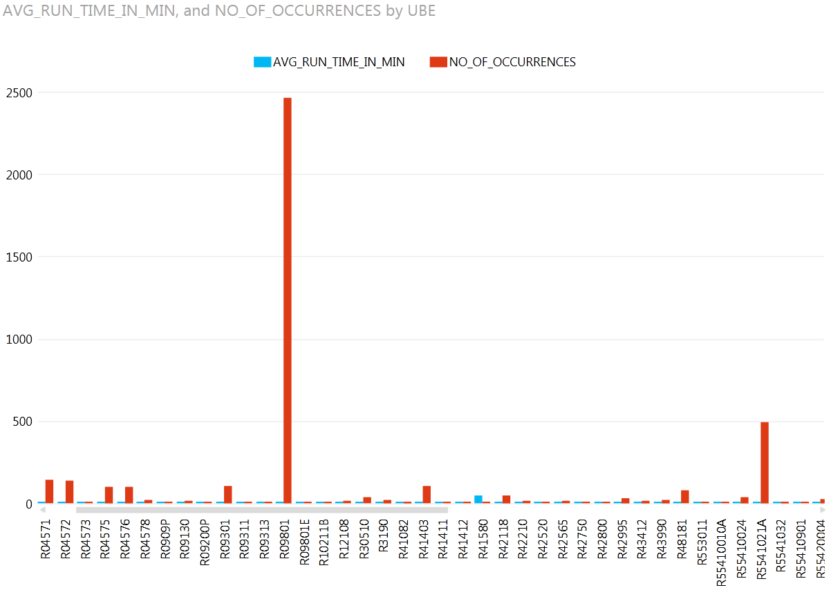
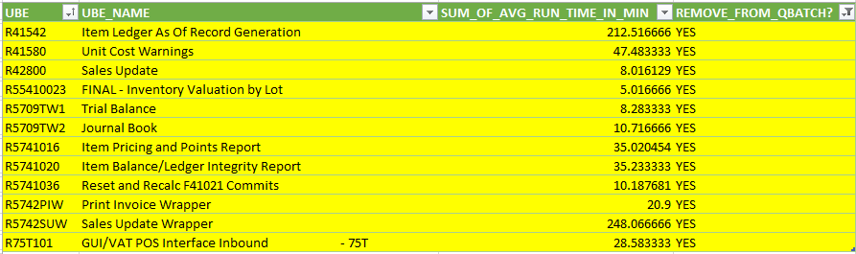
To remove or not to remove (because “to be or not to be” is too mainstream)
UBEs changed based on runtime and number of occurrences
Runtime and occurrence for a UBE were found to inversely related
Removing the UBEs whose runtime>5mins
QBATCH restructured

Slide 13
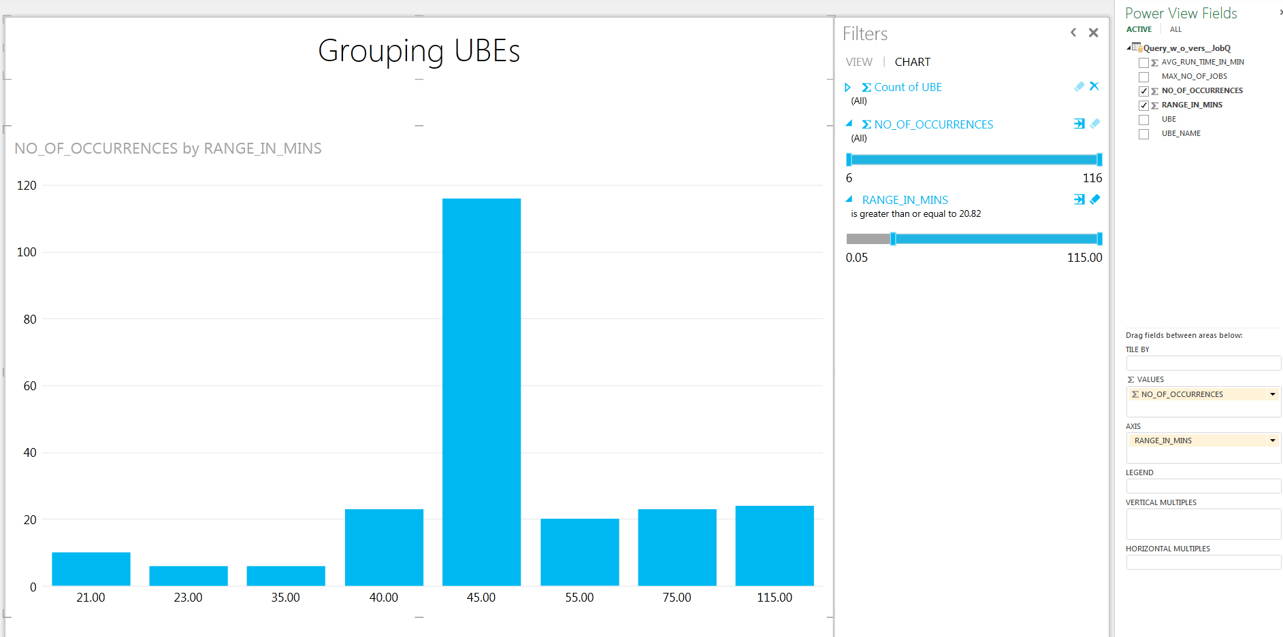
Create new job queues
More occurrences -> need more threads; More ranges of runtime -> need more queues
Queue | Single or Multithread | Runtime range (minutes)
JDESQS | Single | 0 to 2
JDESQM | Single | 2 to 8
JDESQL | Single | 8 to 60
JDESQE | Single | 60 and above
JDEMQS | Multi | 0 to 2
JDEMQM | Multi | 2 to 8
JDEMQL | Multi | 8 to 60
JDEMQE | Multi | 60 and above
Queue | Single or Multithread | Runtime range (minutes)
JDESQS | Single | 0 to 2
JDESQM | Single | 2 to 8
JDESQL | Single | 8 to 40
JDESQE | Single | 40 to 60
JDESQEE | Single | 60 and above
JDEMQS | Multi | 0 to 2
JDEMQM | Multi | 2 to 8
JDEMQL | Multi | 8 to 40
JDEMQE | Multi | 40 to 60
JDEMQEE | Multi | 60 and above

Slide 14
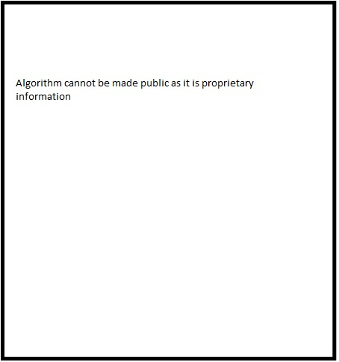
Assigning new queues to UBEs
Algorithm

Slide 15
Something to think about
Bug in the present algorithm
2 solutions to eliminate the bug
Perfect solution
Work around solution
Perfect Solution | Workaround solution
Deploying twice | Deploying once
Changing in OMW twice | Changing in OMW once
An over kill for the current task | Fits well for the current task
True result | Skewed result – affects those UBEs having versions in different queues
Time consuming | quicker
No manual work involved | Requires manual work
Back

Slide 16
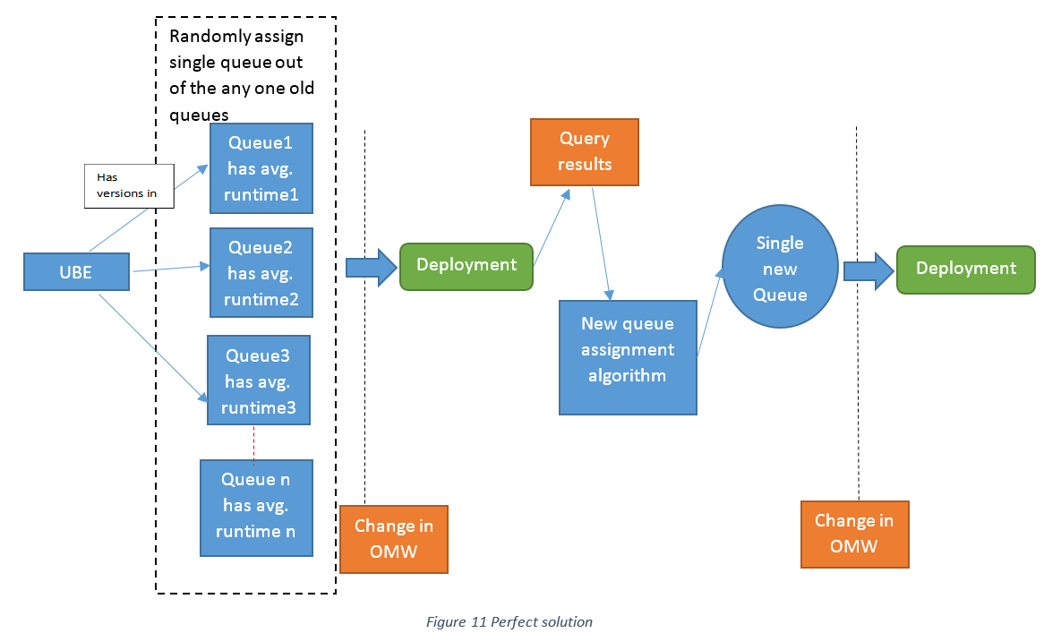
Perfect solution

Slide 17
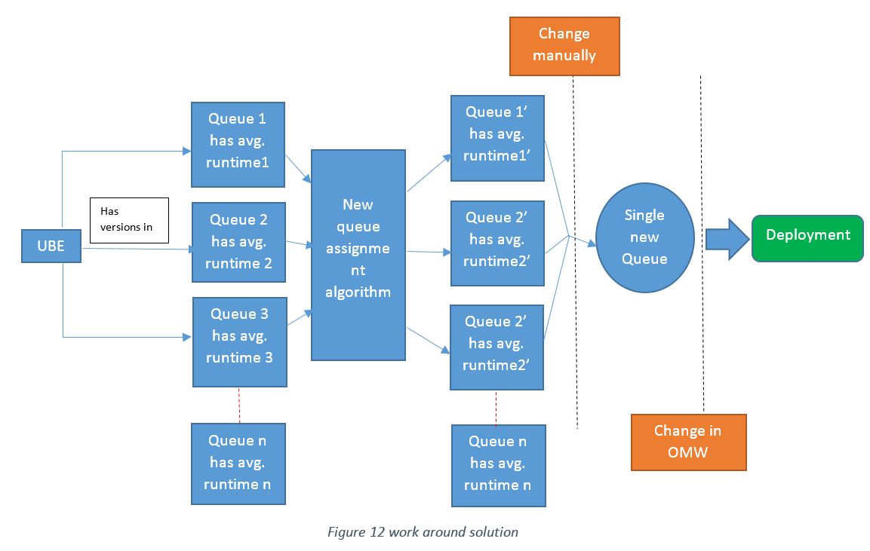
Work around solution
Comparison

Slide 18
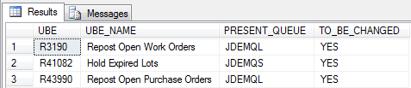
Post deployment analysis
Comparison between the current system and system before deployment
Observations and conclusions
New UBEs, assign them again to fix this issue
Job scheduler overriding the queue for single UBEs
Out of 22 single threaded UBEs running in multithreaded queue before 3 are running in multithreaded queue, those 3 are overridden.
Lesser UBEs having their versions in different queues
Before deployment | As of 07/28/2014, 12:25pm
33 | 26
 | 14 (after deducting those UBEs overridden by scheduler)

Slide 19
Post deployment analysis (continued)
Total time saved per day is 443.5 minutes approx.

Slide 20
Reduced waiting time
UBEs wait time has reduced
Prepared from before and after data for UBEs
As of 27th July
C# script takes only those UBEs that existed before deployment and exists after deployment, performs the difference and dumps the result into the excel file.
Conditional formatting is applied to the excel file

Slide 21
Future works
Regularly checking for new UBEs and assigning them the right queue
Applying the same analysis to scheduler jobs
Maintenance

Slide 22

What did I learn?
SQL
A part of internal working of JDE
Developing applications in JDE
Making projects and changing objects in OMW
C#
Analytical thinking
Problem solving abilities
Giving attention to detail
Working meticulously

Slide 23

Q&A

